Slide 1
Recommendation Systems
PROFOND AI

Slide 2
Agenda
Introduction to recommendation
Why recommendation systems?
Real world examples and historical trends
Basic techniques of recommendation
Evaluation of recommendation
Implementation in python
Advances in recommendation systems

Slide 3
Introduction
Recommendation engines are nothing but an automated form of a “shop counter guy”. You ask him for a product. He not only shows that product, but also the related ones which you could buy. They are well trained in up selling and cross selling.
In today’s world, every customer is facing with multiple choices. Let’s Assume, If a person is looking for a book to read without any specific idea of what he want, there’s a wide range of possibilities how my search might pan out. He might waste a lot of time browsing around on the internet and trawling through various sites hoping to strike gold. He might look for recommendations from other people.

Slide 4
Cont..
But if there is a site or app which could recommend him books based on what he had read previously, that would be a massive help. Instead of wasting time on searching books of his interests on various sites.
In short, our main aim is to recommend the items based on users interests
Recommendation engines Algorithms are one of the most widely used applications of machine learning techniques. From Amazon to Netflix, Google to Goodreads.
we will see various types of recommendation engine algorithms and fundamentals of creating them in Python.

Slide 5
Why Recommendation System?
Helps user find item of their interest.
Helps item provider deliver their items to right user.
Identify products most relevant to the user
Personalized content
Help website improve user engagement.
Recommender system creates a matching between users and items and exploits the similarity between users/items.

Slide 6
What are recommendation engines?
Previously, People generally used to buy the products recommended to them by their friends or the people who they trust. This is how people used to purchase when there was any doubt about the product. But with the advent of the Artificial Intelligence age, that circle has expanded to include online sites that utilize some sort of recommendation engine.
A recommendation engine uses different algorithms and recommends the most relevant items to the users. It initially captures the past behavior of the user’s and based on that, it recommends the products.

Slide 7
Cont..
If a new user visits a site, we will not have any past history of that user. So how does the website go about recommending products to the user in such a scenario? One possible solution could be to recommend the bestselling products, i.e. the products which are trending. Another possible solution could be to recommend the products which would bring the maximum profit to the business and combination with the new products that are added recently to the site.
If we can recommend a few items to a customer based on their interests, it will create a positive impact on the user experience and lead to frequent visits. Hence, smart and intelligent recommendation engines are built by studying the past behavior of their users.

Slide 8
What can be recommended?
Jobs
Research papers
Investment choices
TV programs
Citations
Cloths
Online mates (Dating services)
Supermarket goods
Advertising messages
Movies
Books
Music tracks
News articles
Restaurants
Future friends (Social network sites)
Courses in e-learning

Slide 9
Types of recommendation Engines:
Market Basket Analysis (Association rule mining)
Content based
Collaborative filtering
Hybrid systems
ML Clustering based
ML Classification based
Deep learning and NLP based
Popular based

Slide 10
Market Basket Analysis (Association rule mining):
Market Basket Analysis is used by large retailers to uncover associations between items. It works by looking for combinations of items that are frequently brought together, it allows retailers to identify relationships between the items that people buy.
There are a couple of terms used in association analysis that are important to understand.
Association Rules are widely used to analyze retail basket or transaction data, and are intended to identify strong rules discovered in transaction data using measures of interestingness, based on the concept of strong rules.

Slide 11
Cont..
Association rules are normally written like this: {Bread} -> {Butter} which means that there is a strong relationship between customers that purchased diapers and also purchased beer in the same transaction.
In the above example, the {Bread} is the antecedent and the {Butter} is the consequent. Both antecedents and consequents can have multiple items. In other words, {Bread, Milk} -> {Butter, Chips} is a valid rule.
Support is the relative frequency that the rules show up. In many instances, you may want to look for high support in order to make sure it is a useful relationship. However, there may be instances where a low support is useful if you are trying to find “hidden” relationships.

Slide 12
Cont..
Confidence is a measure of the reliability of the rule. A confidence of 0.5 in the above example would mean that in 50% of the cases where Bread and Milk were purchased, the purchase also included Butter and Chips. For product recommendation, a 50% confidence may be perfectly acceptable but in a medical situation, this level may not be high enough.
Lift is the ratio of the observed support to that expected if the two rules were independent. The basic rule of thumb is that a lift value close to 1 means the rules were completely independent. Lift values > 1 are generally more “interesting” and could be indicative of a useful rule pattern.

Slide 13
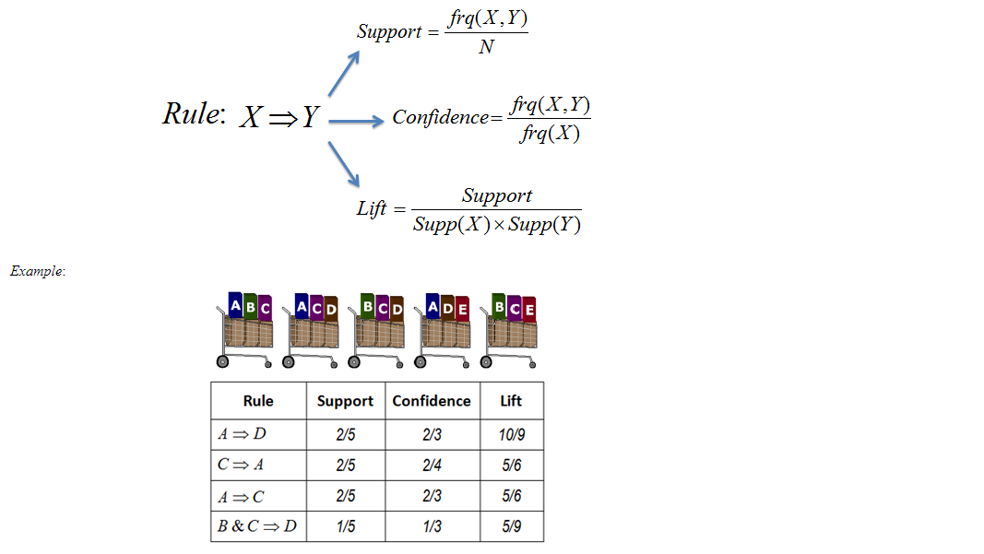
Cont..

Slide 14
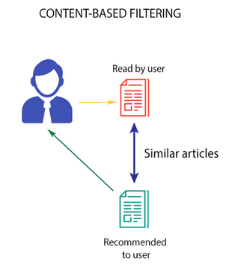
Content Based Filtering
Content Filtering algorithm recommends products which are similar to the ones that a user has liked.

Slide 15

Cont..
Consider the example of Netflix. They save all the information related to each user in a vector form. This vector contains the past behavior of the user, i.e. the movies liked/disliked by the user and the ratings given by them. This vector is known as the profile vector. All the information related to movies is stored in another vector called the item vector. Item vector contains the details of each movie, like genre, cast, director, etc.
The content-based filtering algorithm finds the cosine of the angle between the profile vector and item vector, i.e. cosine similarity. Suppose X is the profile vector and Y is the item vector, then the similarity between them can be calculated as:

Slide 16
Cont..
Based on the cosine value, which ranges between -1 to 1, the movies are arranged in descending order and one of the two below approaches is used for recommendations:
Top-n approach: where the top n movies are recommended (Here n can be decided by the business)
Rating scale approach: Where a threshold is set and all the movies above that threshold are recommended

Slide 17

Cont..
Other methods that can be used to calculate the similarity are:
Euclidean Distance: Similar items will lie in close proximity to each other if plotted in n-dimensional space. So, we can calculate the distance between items and based on that distance, recommend items to the user. The formula for the Euclidean distance is given by:
Pearson’s Correlation: It tells us how much two items are correlated. Higher the correlation, more will be the similarity. Pearson’s correlation can be calculated using the following formula:

Slide 18
Cont..
A major drawback of this algorithm is that it is limited to recommending items that are of the same type. It will never recommend products which the user has not bought or liked in the past. So if a user has watched or liked only action movies in the past, the system will recommend only action movies. It’s a very narrow way of building an engine.
To improve on this type of system, we need an algorithm that can recommend items not just based on the content, but the behavior of users as well.

Slide 19
Collaborative Filtering
If a person A likes item 1, 2, 3 and B like 2,3,4 then they have similar interests and A should like item 4 and B should like item 1.
This algorithm is entirely based on the past behavior and not on the context. This makes it one of the most commonly used algorithm as it is not dependent on any additional information.
For instance: product recommendations by e-commerce player like Amazon and merchant recommendations by banks like American Express

Slide 20
Cont..
Further, there are several types of collaborative filtering algorithms:
User-User Collaborative filtering: Here we find look alike customers (based on similarity) and offer products which first customer’s look alike has chosen in past. This algorithm is very effective but takes a lot of time and resources. It requires to compute every customer pair information which takes time. Therefore, for big base platforms, this algorithm is hard to implement without a very strong parallelizable system.

Slide 21
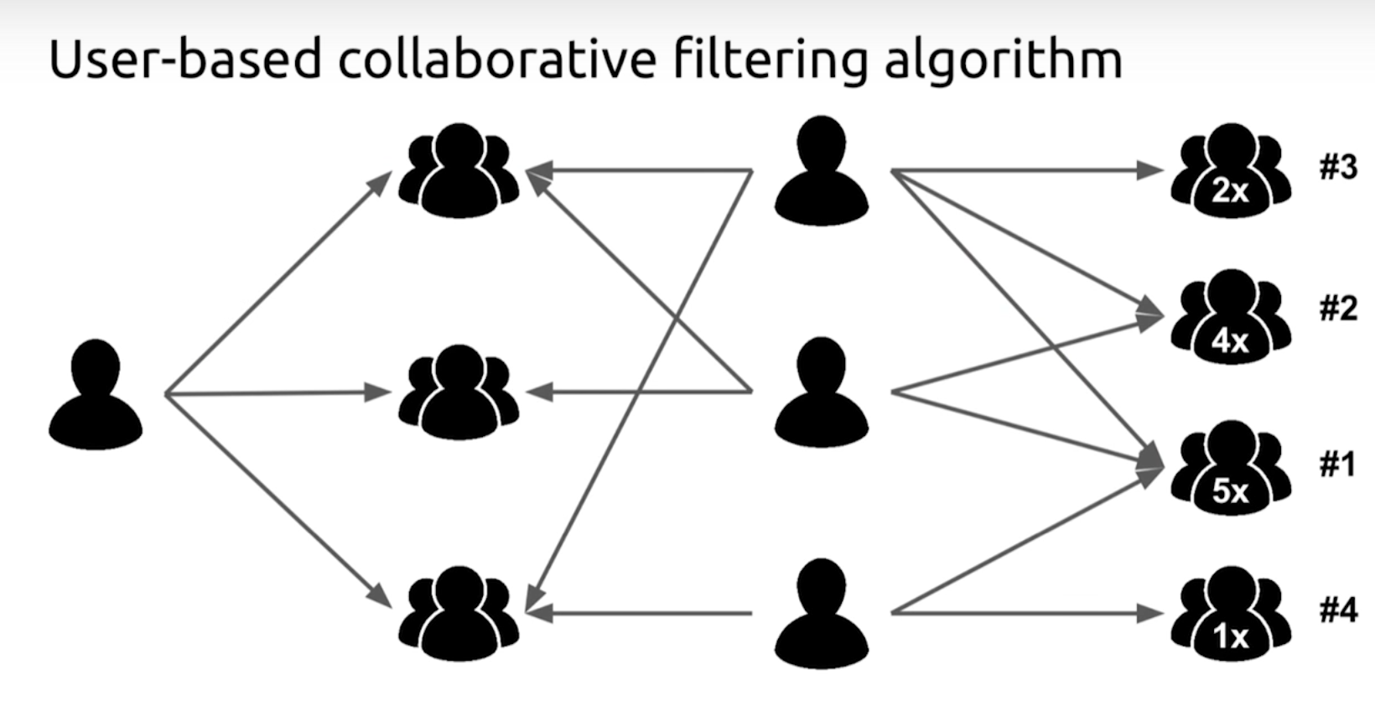

Slide 22
Cont..
Item-Item Collaborative filtering: It is quite similar to previous algorithm, but instead of finding customer look alike, we try finding item look alike. Once we have item look alike matrix, we can easily recommend alike items to customer who have purchased any item from the store. This algorithm is far less resource consuming than user-user collaborative filtering. Hence, for a new customer the algorithm takes far lesser time than user-user collaborate as we don’t need all similarity scores between customers. And with fixed number of products, product-product look alike matrix is fixed over time.

Slide 23
